Slide 1
ETHICS AND MANAGEMENT
Annabelle Fabregal

Slide 2
SUMMARY
Definiton
Types of management and its role
Ethical Behavior
Managing Ethical Behavior
Conclusion

Slide 3
What does « ethic » mean ?

Slide 4
ethics
Principles, values, and beliefs that define what is right and wrong behavior.
What about Ethics and Management ?
Management Ethics is the discipline dealing with what is right and wrong, or with moral duty and obligation. It is a standard of behavior that guides individual managers in their works.

Slide 5
Different approaches in management ethics
Utilitarian approach
Managers analyze the effects of decisions on people affected by these decisions. The action rather than the motive behind the action is the focus of this approach. Positive and negative results are weighed and managerial actions are justified if positive effects outweigh the negative effects.
Moral rights approach
Managers follow ethical code which takes care of fundamental and moral rights of human beings; the right to speech, right to life and safety, right to express feelings etc. In the context of business organizations, managers disclose information in the annual reports necessary for welfare of the people concerned. The nature, timing and validity of information is taken into account while reporting information in the annual reports.
Social justice approach
Managers’ actions are fair, impartial and equitable to all individuals and groups. Employees are not distinguished on the basis of caste, religion, race or gender though distinction on the basis of abilities or production is justified.

Slide 6
Different approaches in management ethics
EXAMPLES
Managers don't eavesdrop on employees to respect their right to privacy.
Utilitarian approach – Moral rights approach – Social justice approach
All employees, males or females with same skills should be treated at par but it is justified to treat employees who produce more differently from those who produce less.
Utilitarian approach – Moral rights approach – Social justice approach
Managers analyze the impact of the action on society’s pollution
Utilitarian approach – Moral rights approach – Social justice approach

Slide 7
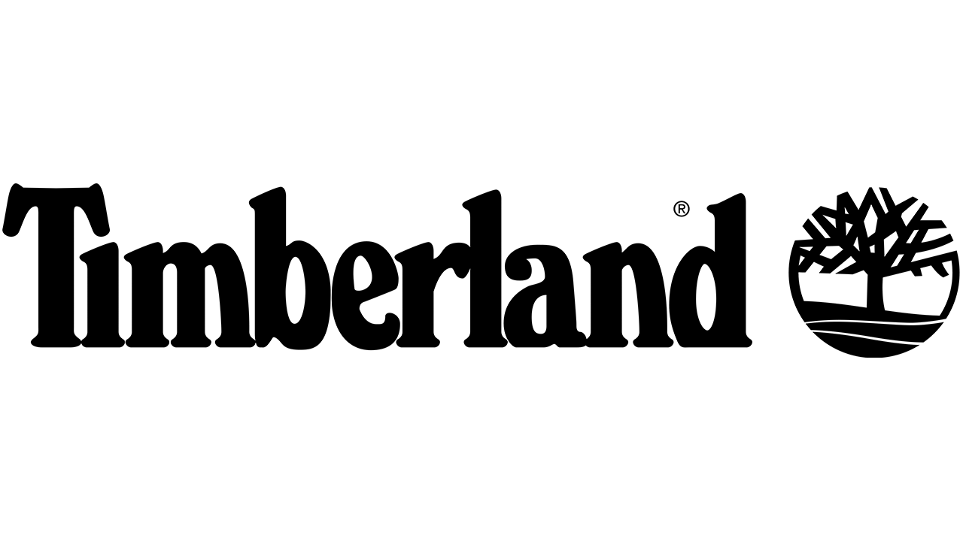
Other types of management
Moral Management by Archie B. Caroll
According to moral management ethics, managers aim to maximize profits within the confines of ethical values and principles. They conform to professional and legal standards of conduct. The guiding principle in moral management ethics is “Is this action, decision, or behavior fair to us and all parties involved?”
Values-based management
The organization’s values guide employees in the way they do their jobs. These values reflect what the organization stands for and what it believes in as well as create an environment that influences employee behavior ethically or unethically.
“Everything we do at Timberland grows out of our relentless pursuit to find a way to make it better.”
Make it better
Notes:
Employees at Timberland know what’s expected and valued; that is, find ways to “make it better”—whether it’s creating quality products for customers, performing community service activities, designing employee training programs, or figuring out ways to make the company’s packaging more environmentally friendly.

Slide 8
Ethical behavior ?
Ethical behavior
Conforms to generally accepted social norms.
Unethical behavior
Does not conform to generally accepted social norms.
Unethical behavior on the part of the company and its management creates a situation where employees feel ashamed or embarrassed by their company, its product or service, or their role in it. It is as if they are doing something wrong by association.
What are the stages of Moral Development ?
Notes:
Research divides moral development into three levels, each having two stages. At each successive stage, an individual’s moral judgment becomes less dependent on outside influences and more internalized.
At the first level, the preconventional level, a person’s choice between right or wrong is based on personal consequences from outside sources. At the second level, the conventional level, ethical decisions rely on maintaining expected standards and living up to the expectations of others. At the principled level, individuals define moral values apart from the authority of the groups to which they belong or society in general.

Slide 9
Ethical behavior ?
Individual characteristics
values
personnality
Ego strengh
Locus of control
Play a role in determining whether a person behaves ethically.
Notes:
Our values develop from a young age based on what we see and hear from parents, teachers, friends, and others. Thus, employees in the same organization often possess very different values.
Two personality variables have been found to influence an individual’s actions according to his or her beliefs about what is right or wrong :
Ego strength measures the strength of a person’s convictions. People with high ego strength are likely to resist impulses to act unethically and instead follow their convictions. That is, individuals high in ego strength are more likely to do what they think is right and be more consistent in their moral judgments and actions than those with low ego strength.
Locus of control is the degree to which people believe they control their own fate. People with an internal locus of control believe they control their own destinies. They’re more likely to take responsibility for consequences and rely on their own internal standards of right and wrong to guide their behavior. They’re also more likely to be consistent in their moral judgments and actions. People with an external locus believe what happens to them is due to luck or chance. They’re less likely to take personal responsibility for the consequences of their behavior and more likely to rely on external forces.

Slide 10
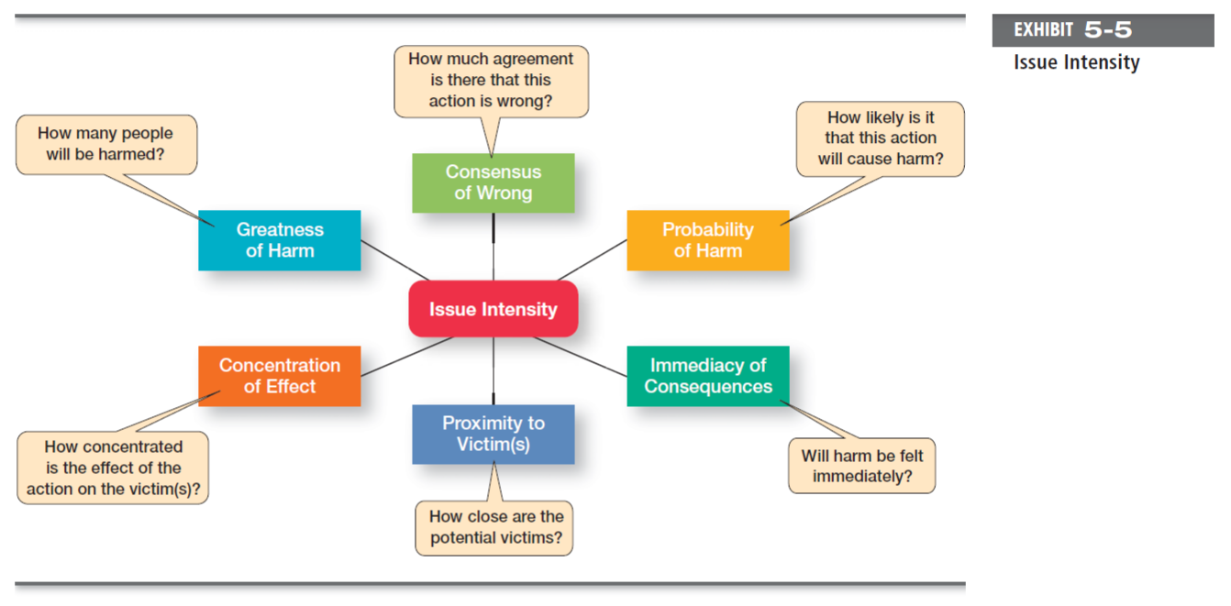
Ethical behavior ?
Issues intensity
Notes:
Six characteristics determine issue intensity or how important an ethical issue is to an individual.
These factors suggest that the larger the number of people harmed, the more agreement that the action is wrong, the greater the likelihood that the action will cause harm, the more immediately that the consequences of the action will be felt, the closer the person feels to the victim(s), and the more concentrated the effect of the action on the victim(s), the greater the issue intensity or importance. When an ethical issue is important, employees are more likely to behave ethically.

Slide 11
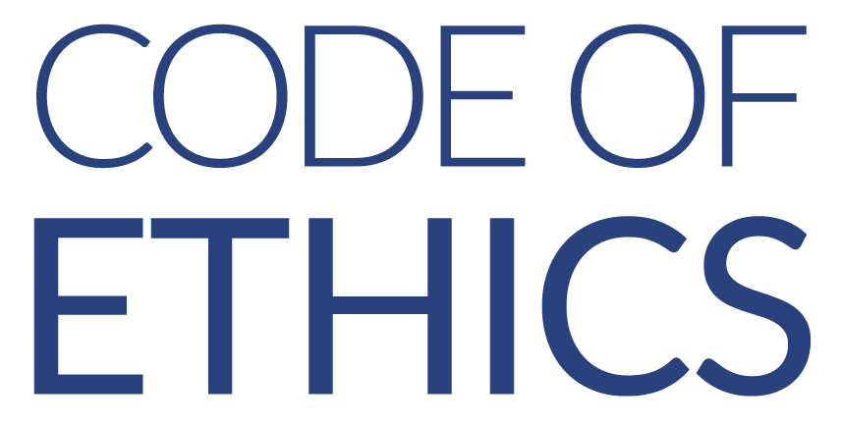
How to manage with an ethical behavior ?
Paying attention to employee selection
A formal statement of an organization’s primary values and the ethical rules it expects its employees to follow.
And you, what do you think is important when managing with ethical behavior ?
Leadership role
= what they do is more important
Using ethics training
Acting in the best interest of shareholders and stake holders
Taking into account how goals are achieved
Notes:
workshops, and similar ethics that increases awareness of ethical issues in business.
A company's or profession's code of ethics, also called code of conduct, refers to the areas of activities that can create ethical dilemmas and risks and is designed to provide employees guidance on how to act in unclear situations and make the right decisions.

Slide 12
EXAMPLE IN PRACTICE
“We believe that conducting business ethically and striving to do the right thing are vital to the success of the company”
Providing resources that help partners make ethical decisions
Ethical leadership and conducting business with integrity
Advising and enabling leaders to drive ethical business practices
Encouraging partners to speak up if they have questions or concerns
The Starbucks Standards of Business Conduct
For the 12th year in a row, Starbucks has been recognized as one of the World’s Most Ethical Companies® by the Ethisphere Institute.
Notes:
https://www.youtube.com/watch?v=VpPisi1F5jI&list=PL4DD39D3B9D8389D3&index=2
Starbucks' Code of Ethics.
The main focus of Starbuck's code of ethics is its strong environmental commitment and the focus on being involved in local community projects. The code of conduct is designed to go beyond prohibiting negative actions. It encourages the workforce to do more and go beyond compliance and ethical codes. The code of ethics designed by Starbucks is a great example of how to communicate the culture of the organization and engage with workers on an emotional level.
Another strength of Starbucks' code of conduct is the detailed frequently asked questions section. It lists the different help lines and advisory services set up by the company to aid employees in ethically challenging situations.

Slide 13
Conclusion : why are business ethics important
Business organizations are economic and social institutions that serve customers’ needs by supplying them right goods at the right place, time and price. This is possible if the institutions engage in ethical practices.
Business ethics help in long-run survival of the firms
Ethical business activities improve company’s image and give it edge over competitors to promote sales and profits.
The behavior of managers is the single most important influence on an individual’s decision to act ethically or unethically.

Slide 14
THANK YOU FOR LISTENING
Ethics and Management

Slide 15
SOURCES
Book Robins coulter management 11 edt 2012, « Chapter 5 - Managing social responsibility and ethics »
Webiste Merriam-Webster : https://www.merriam-webster.com/dictionary/ethic
Webiste Business Management ideas,
« Management Ethics: Meaning, Need and Importance » :
https://www.businessmanagementideas.com/notes/management-notes/corporate-social-responsibility/management-ethics-meaning-need-and-importance/5319
« Ethical and Unethical Behaviour at Workplace | Ethics | Management »
https://www.businessmanagementideas.com/business/ethics-business/ethical-and-unethical-behaviour-at-workplace-ethics-management/12059
YouTube link Gregg Learning, « Ethics in Management »
https://www.youtube.com/watch?v=0vScvaAw56g
Website Upcounsel, « Code of Ethics Examples: Everything You Need to Know »
https://www.upcounsel.com/code-of-ethics-examples
Website Starbucks, « Ethics & Compliance »
https://www.starbucks.com/about-us/company-information/business-ethics-and-compliance
YouTube link Starbucks, « Retail Careers at Starbucks »
https://www.youtube.com/watch?v=VpPisi1F5jI&list=PL4DD39D3B9D8389D3&index=2

